Slide 1
Introduction to Yoga-Goga-Boom: Your New Yoga Studio in the Neighborhood

Slide 2
Agenda
Welcome to Yoga-Goga-Boom
Our Vision and Values
Our Expert Trainers
Yoga for Adults
Yoga for Kids
Therapeutic Aerial Yoga
Our Studio Spaces
Community Engagement
Special Offers and Membership
Join Us at Yoga-Goga-Boom

Slide 3
Welcome to Yoga-Goga-Boom
Introduction to our new community yoga studio
Yoga-Goga-Boom is a brand new yoga studio opening its doors in your neighborhood. Our goal is to provide a welcoming space where everyone can practice yoga and enjoy the benefits it brings to physical and mental well-being.
Owned and operated by certified yoga instructor
I am [Your Name], a certified yoga instructor with years of experience in guiding individuals towards a healthier lifestyle through yoga. I am thrilled to bring this new studio to our community.
Mission: Promote wellness for all ages
Our mission at Yoga-Goga-Boom is to promote wellness for individuals of all ages. We believe in the power of yoga to transform lives by enhancing physical fitness, mental clarity, and emotional balance.
Notes:
Good [morning/afternoon/evening], and welcome to Yoga-Goga-Boom! My name is [Your Name], and I'm the owner and one of the certified yoga instructors here. Today, I'm excited to introduce you to our new community yoga studio. Our mission is simple but powerful: to promote wellness for all ages in a warm and welcoming environment. Let's dive into what Yoga-Goga-Boom is all about!

Slide 4
Our Vision and Values
Commitment to holistic wellness
We are committed to providing a holistic approach to wellness that considers all aspects of an individual's well-being, including their physical, mental, and emotional health.
Creating a supportive and inclusive environment
Our studio aims to be a supportive and inclusive space where everyone, regardless of age, experience level, or background, feels welcome and encouraged to practice yoga.
Encouraging mindfulness and personal growth
At Yoga-Goga-Boom, we encourage mindfulness and personal growth through our classes, helping each person connect deeply with their mind and body, fostering a sense of inner peace and resilience.
Notes:
At Yoga-Goga-Boom, our vision is to foster holistic wellness that benefits both the mind and body. We are committed to creating a supportive and inclusive environment where everyone feels welcome. Our values are rooted in mindfulness and personal growth, encouraging each member to embark on their own unique wellness journey.

Slide 5
Our Expert Trainers
Meet our certified yoga instructors
Our team of instructors is composed of highly trained and certified yoga professionals who are passionate about teaching and supporting your yoga journey.
Years of experience and specialized training
Each of our instructors brings years of experience and specialized training in various forms of yoga, ensuring that you receive expert guidance and support.
Dedication to individual progress and safety
Our trainers are dedicated to helping each individual progress at their own pace while ensuring their safety throughout their practice.
Notes:
Our studio is proud to have a team of highly certified yoga instructors with years of experience and specialized training. Each trainer is dedicated to ensuring individual progress and safety. Whether you're a beginner or an advanced practitioner, our instructors are here to guide you every step of the way.

Slide 6
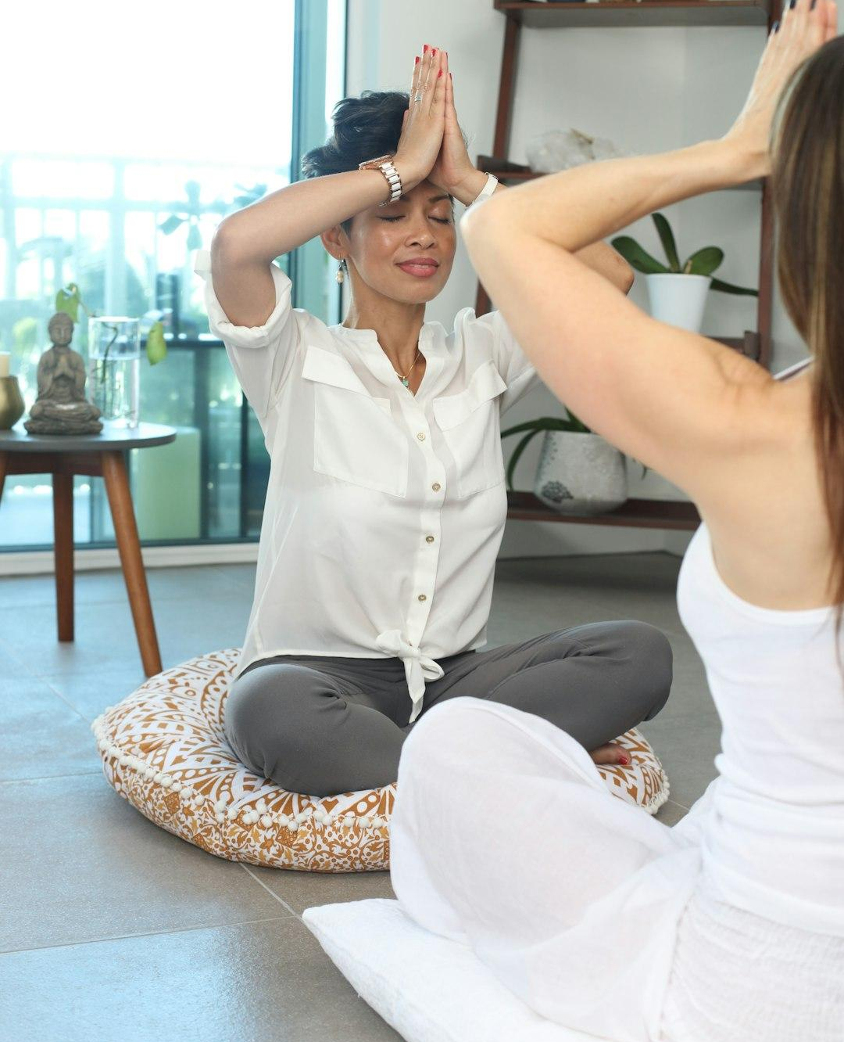
Yoga for Adults
Classes tailored to all skill levels
We offer a range of classes tailored to all skill levels, from beginners to advanced practitioners, so everyone can find a class that suits their needs.
Various styles: Hatha, Vinyasa, Yin, and more
Our adult yoga classes encompass various styles, including Hatha, Vinyasa, Yin, and more, providing diverse approaches to practice yoga.
Special workshops and advanced training
We also provide special workshops and advanced training sessions for those who wish to deepen their practice or explore specific aspects of yoga.
Photo by Antonika Chanel on Unsplash
Notes:
We offer a variety of yoga classes tailored to all skill levels. Whether you're new to yoga or a seasoned yogi, we have something for you. Our classes include Hatha, Vinyasa, Yin, and more. Additionally, we regularly host special workshops and advanced training sessions to deepen your practice.

Slide 7
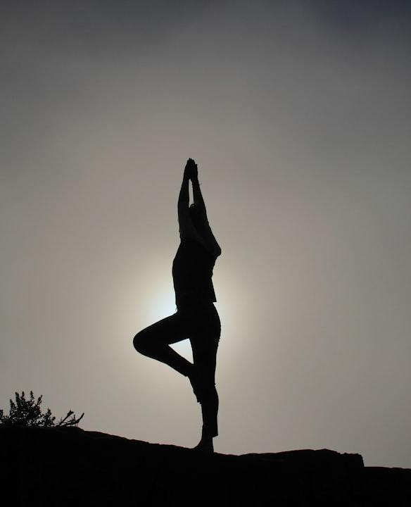
Yoga for Kids
Fun and engaging yoga classes for children
Our yoga classes for kids are designed to be fun and engaging, making yoga a playful and enjoyable experience for children.
Fosters concentration, balance, and confidence
Through yoga, children can improve their concentration, balance, and confidence, helping them develop important skills that benefit their overall growth.
Safe and nurturing environment
We ensure that our yoga sessions for kids are conducted in a safe and nurturing environment, where they can explore and grow at their own pace.
Photo by Patrick Hendry on Unsplash
Notes:
Our yoga classes for kids are designed to be fun and engaging. They help children develop concentration, balance, and confidence in a safe, nurturing environment. We believe that starting a yoga practice at a young age sets the foundation for a lifelong journey of wellness and mindfulness.

Slide 8
Therapeutic Aerial Yoga
Introduction to aerial yoga benefits
Aerial yoga combines traditional yoga poses with the use of a hammock, offering numerous benefits such as improved flexibility, strength, and relaxation.
Combines traditional yoga with aerial acrobatics
This practice integrates traditional yoga with elements of aerial acrobatics, creating a unique and enjoyable experience for practitioners.
Enhances flexibility, strength, and relaxation
Therapeutic aerial yoga enhances flexibility, builds strength, and provides deep relaxation, making it suitable for individuals seeking a different approach to their yoga practice.
Notes:
One of the unique offerings at Yoga-Goga-Boom is Therapeutic Aerial Yoga. This form of yoga combines traditional yoga poses with the thrill and relaxation of aerial acrobatics. It enhances flexibility, strength, and relaxation, offering a new dimension to your yoga practice.

Slide 9
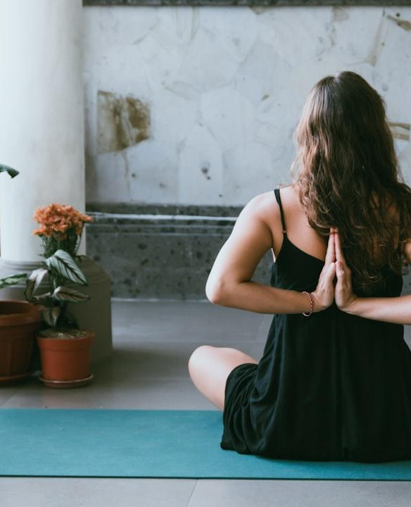
Our Studio Spaces
Separate areas for adults and kids
Our studio features separate areas for adults and kids, ensuring that both groups have a suitable environment for their practice.
Modern, clean, and well-equipped facilities
We take pride in our modern, clean, and well-equipped facilities, which are designed to provide the best possible experience for our members.
Calming ambiance designed for optimal practice
The ambiance of our studio is carefully designed to be calming and conducive to optimal practice, allowing you to fully immerse yourself in your yoga session.
Photo by Avrielle Suleiman on Unsplash
Notes:
Our studio features separate areas dedicated to adults and kids, ensuring each group has a space tailored to their needs. Both areas are modern, clean, and well-equipped with all the necessary props for a complete yoga experience. The calming ambiance of our studios is designed to enhance your practice and promote relaxation.

Slide 10
Community Engagement
Monthly community events and workshops
We host monthly community events and workshops to foster a sense of community, provide learning opportunities, and encourage social connections.
Opportunities for family yoga sessions
Our family yoga sessions offer a wonderful opportunity for parents and children to practice yoga together, strengthening family bonds through shared experiences.
Partnerships with local schools and organizations
We partner with local schools and organizations to bring the benefits of yoga to a wider audience and support community wellness initiatives.
Notes:
We believe in the power of community, and we host monthly events and workshops to bring our members together. These include family yoga sessions and partnerships with local schools and organizations. Our goal is to build a strong, supportive community both inside and outside the studio.

Slide 11
Special Offers and Membership
Introductory offers for new members
We have special introductory offers for new members, making it easy to start your yoga journey with us at affordable rates.
Flexible membership plans
Our flexible membership plans are tailored to suit different schedules and needs, ensuring that everyone can find a plan that works for them.
Discounts for families and groups
We offer discounts for families and groups, encouraging you to invite your loved ones and friends to join our yoga community.
Notes:
To help you get started, we have some fantastic introductory offers for new members. Our membership plans are designed to be flexible, catering to different schedules and needs. Additionally, we offer discounts for families and groups to make yoga accessible to everyone.

Slide 12
Join Us at Yoga-Goga-Boom
Encouragement to book a class today
We invite you to book a class today and experience the unique offerings at Yoga-Goga-Boom. Join us to start or deepen your yoga journey in a supportive environment.
Contact information and location details
For more information, visit us at [Address], or contact us at [Phone Number] and [Email Address].
Follow us on social media for updates and tips
Stay connected and inspired by following us on social media. Get the latest updates, yoga tips, and more from our vibrant community.
Notes:
Thank you for taking the time to learn about Yoga-Goga-Boom. We invite you to book a class today and start your journey towards better wellness with us. For more information, please visit our website, and follow us on social media for updates and wellness tips. We look forward to practicing with you soon!

